Slide 1
Binary Tree Traversals
Asim Rehan

Slide 2
Traversals
“Displaying (or) visiting order of nodes in a binary tree is called as Binary Tree Traversal”
There are three types of binary tree traversals.
In - Order Traversal
Pre - Order Traversal
Post - Order Traversal
Notes:
When we wanted to display a binary tree, we need to follow some order in which all the nodes of that binary tree must be displayed. In any binary tree, displaying order of nodes depends on the traversal method.

Slide 3
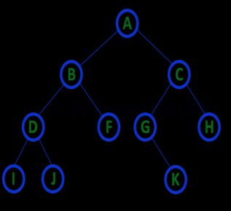
In-Order traversal
In In-Order traversal, the root node is visited between the left child and right child.
Notes:
In this traversal, the left child node is visited first, then the root node is visited and later we go for visiting the right child node.

Slide 4
In-Order traversal
I - D - J - B - F - A - G - K - C - H

Slide 5
Pre-Order traversal
In Pre-Order traversal, the root node is visited before the left child and right child nodes.
Notes:
In this traversal, the root node is visited first, then its left child and later its right child.

Slide 6
Pre-Order traversal
A - B - D - I - J - F - C - G - K - H

Slide 7
Post - Order Traversal
In Post-Order traversal, the root node is visited after left child and right child.
Notes:
In this traversal, left child node is visited first, then its right child and then its root node. This is recursively performed until the right most node is visited.

Slide 8
Post-Order traversal
I - J - D - F - B - K - G - H - C - A

Slide 9
Task
Perform: In-order, Pre-Order and Post-Order traversals.
+
*
/
A
B
%
E
C
D

